Slide 1
Mean-Square Error Linear Estimation Session 13 & 14
Course : COMP6577 – Machine Learning
Effective Period : February 2020

Slide 2
Learning Outcome
LO2: Student be able to interpret the distribution of dataset using regression method

Slide 3
Outline
The cost function surface
A geometric viewpoint (orthogonality condition)
Case Study

Slide 4

The Normal Equations
The general estimation task has been introduced in the previous Topic.
Given two dependent random vectors, y and x, the goal of the estimation task is to obtain a function, g, so as, given a value x of x, to be able to predict (estimate), in some optimal sense, the corresponding value y of y, or = g(x).
The optimal MSE estimate of y given the value x = x is
In general, this is a nonlinear function.

Slide 5




Mean-Square Error Linear Estimation
We now turn our attention to the case where g is constrained to be a linear function.
Let (y, x) ∈ be two jointly distributed random entities of zero mean values. In case the mean values are not zero, they are subtracted.
Our goal is to obtain an estimate of θ ∈ in the linear estimator model,
So that the cost function is minimum,

Slide 6

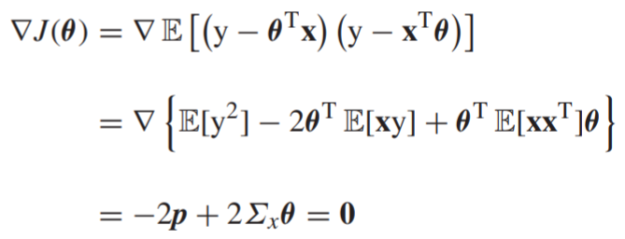

In other words, the optimal estimator is chosen so as to minimize the variance of the error random variable
Minimizing the cost function J(θ) is equivalent with setting its gradient with respect to θ equal to zero,

Slide 7


where the input-output cross-correlation vector p is given by
and the respective covariance matrix is given by
Thus, the weights of the optimal linear estimator are obtained via a linear system of equations, provided that the covariance matrix is positive definite and hence it can be inverted. Moreover, in this case, the solution is unique.
On the contrary, if Σ_{x} is singular and hence cannot be inverted, there are infinitely many solutions.

Slide 8

The Cost Function Surface
Elaborating on the cost function, J(θ), as it is defined before, we get that J(θ) = σ_{y}² − 2θ^{T}p + θ^{T}Σ_{x}θ.
Adding and subtracting the term θ∗^{T} Σ_{x}θ∗ and taking into account the definition of θ∗ from the normal equation, it is readily seen that
Where
Is the minimum achieved at the optimal solution.

Slide 9
The Cost Function Surface (continue)
The cost at the optimal value θ∗ is always less than the variance E[y²] of the output variable. This is guaranteed by the positive definite nature of Σ_{x} or Σ_{x}⁻¹, which makes the second term on the right-hand side always positive, unless p = 0; However, the cross-correlation vector will only be zero if x and y are uncorrelated.
In this case, one cannot say anything (make any prediction) about y by observing samples of x, at least as far as the MSE criterion is concerned, which turns out to involve information residing up to the second order statistics.
In this case, the variance of the error, which coincides with J(θ∗ ), will be equal to the variance σ_{y}² ; the latter is a measure of the “intrinsic” uncertainty of y around its (zero) mean value.
On the contrary, if the input-output variables are correlated, then observing x removes part of the uncertainty associated with y.

Slide 10
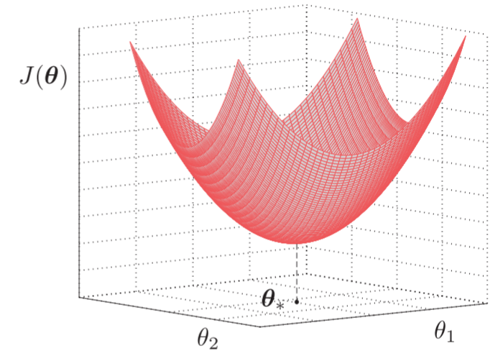
The Cost Function Surface (continue)
For any value θ, other than the optimal θ∗ ,the error variance increases as suggests, due to the positive definite nature of Σ_{x}.
The figure shows the cost function (mean-square error) surface defined by J(θ).

Slide 11
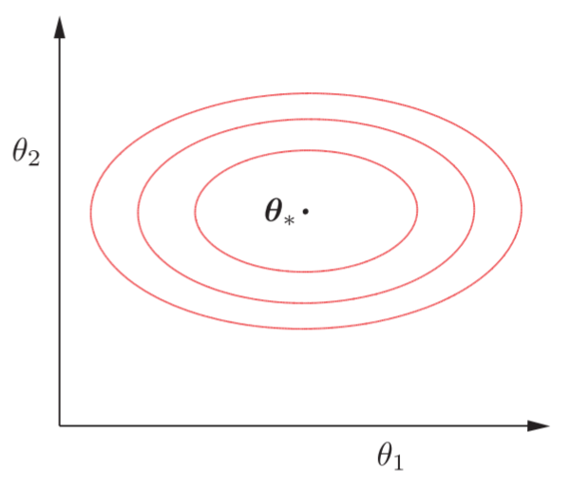
The Cost Function Surface (continue)
The corresponding isovalue contours are shown in figure below. In general, they are ellipses, whose axes are determined by the eigenstructure of Σ_{x}. For Σ_{x} = σ² I, where all eigenvalues are equal to σ², the contours are circles

Slide 12

A Geometric Viewpoint: Orthogonality Condition
What we have discussed so far comes from the geometric interpretation of the random variables.
The set of random variables is a vector space over the field of real (and complex) numbers.
If x and y are any two random variables then x + y, as well as αx, are also random variables for every α ∈
this vector space equipped with an inner product operation, which also implies a norm and makes it a Euclidean space.
The mean value operation has all the properties required for an operation to be called an inner product.

Slide 13
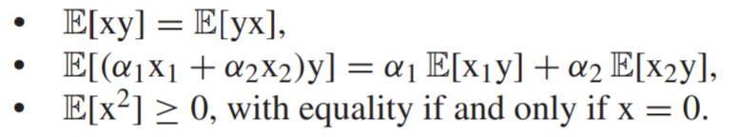

Indeed, for any subset of random variables
Thus, the norm induced by this inner product ||x|| coincides with the respective standard deviation (assuming E[x] = 0).

Slide 14


Given two uncorrelated random variables, x, y, or E[xy] = 0, we can call them orthogonal, because their inner product is zero.
We are now free to apply to our task of interest any one of the theorems that have been derived for Euclidean spaces.
Let us now rewrite the equation:
Thus, the random variable, ŷ, which is now interpreted as a point in a vector space, results as a linear combination of l elements in this space.
Thus, the estimate, ŷ, will necessarily lie in the subspace spanned by these points. In contrast, the true variable, y, will not lie, in general, in this subspace.

Slide 15
Because our goal is to obtain a ŷ that is a good approximation of y, we have to seek the specific linear combination that makes the norm of the error, e = y − ŷ, minimum.
This specific linear combination corresponds to the orthogonal projection of y onto the subspace spanned by the points x₁, x₂, ... , x_{l}. This is equivalent with requiring

Slide 16
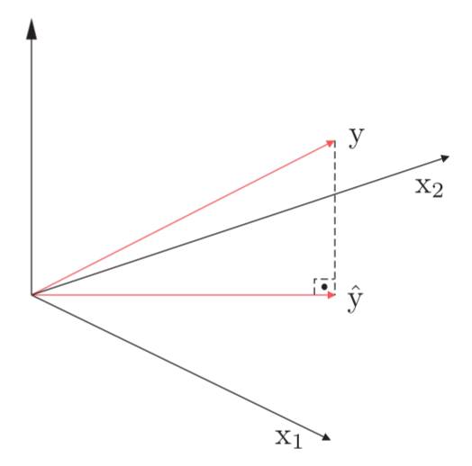
The error variable being orthogonal to every point x_{k}, k = 1, 2, ... , l, will be orthogonal to the respective subspace.
Such a choice guarantees that the resulting error will have the minimum norm; by the definition of the norm, this corresponds to the minimum MSE, or E[e²].

Slide 17
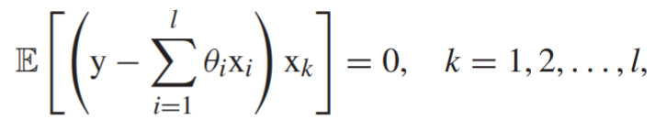
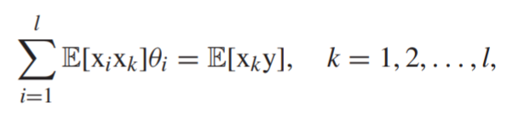
The set of Orthogonality Condition equations can now be written as:
Or
Which leads to Normal equations. Another name is Wiener-Hopf equations.

Slide 18
Case Study
Given data of Singapore Airbnb which can be downloaded in this link
https://www.kaggle.com/jojoker/singapore-airbnb
From the parameter estimated in the last session, discuss and give the overview of the cost function.

Slide 19
End of Session 13&14

Slide 20
References
Sergios Theodoridis. (2015). Machine Learning: a Bayesian and Optimization Perspective. Jonathan Simpson. ISBN: 978-0-12-801522-3. Chapter 4.
https://www.kaggle.com/jojoker/singapore-airbnb

